Slide 1
L4/5 - Group 8
Charlie Kinglake
Andreea Mazarianu
Michael Davis
George Smuts

Slide 2

Game Summary
2D Game
Turn-taking
Competitive
Symmetrical
Twitch
Played on a single mobile device

Slide 3

Game Loop
Send food/rotten food to the other player
Gain/lose score depending which food is collected
Collect food at specific times

Slide 4
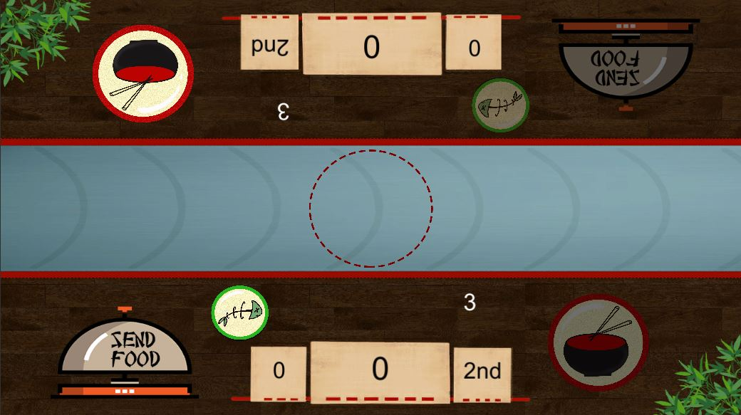
Player Experience
Serious Fun
Rhythm
Repetition
Focus
Hard Fun
Goals
Frustration
Fiero
People Fun
Competition
Schadenfreude

Slide 5
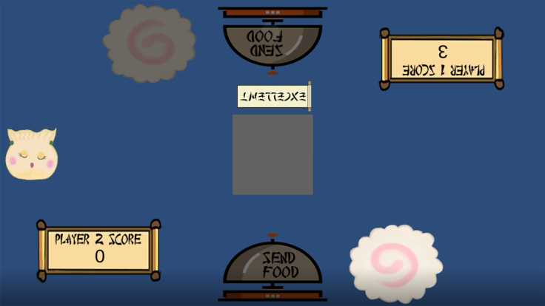

Changes Made Since Pitch One
Multiple food sent each turn
Combo mechanic
Player position
Send “bad” food mechanic
“Bad” food removes score when collected
Updated art assets
Visual feedback for deducted score
Instructions screen

Slide 6

What Could Be Improved
Sounds for button press
Slight increase in speed each turn
Intuitive rotten food counter

Slide 7
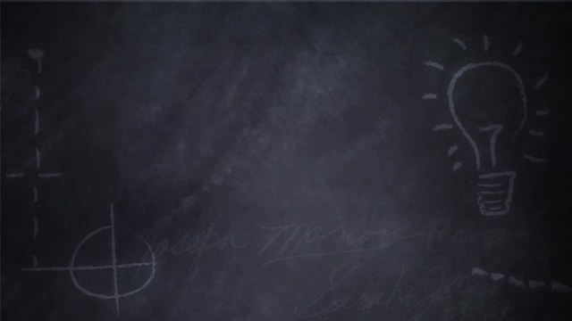
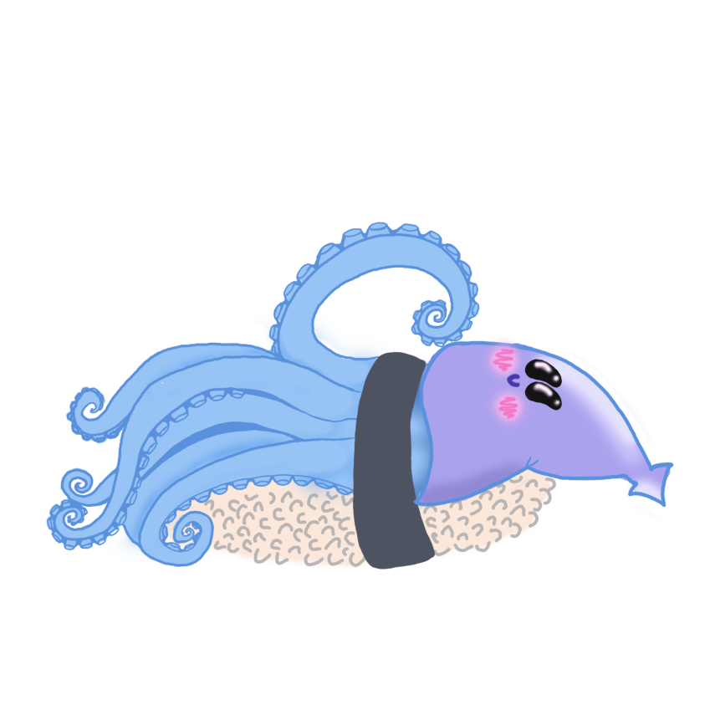
Design Lessons
The importance of research
Communication facilitates work
There is always going to be a minority that does not appreciate your game
The artstyle determines the first emotional response from the player
Choose based on schema , not on what you would like to see in the game

Slide 8
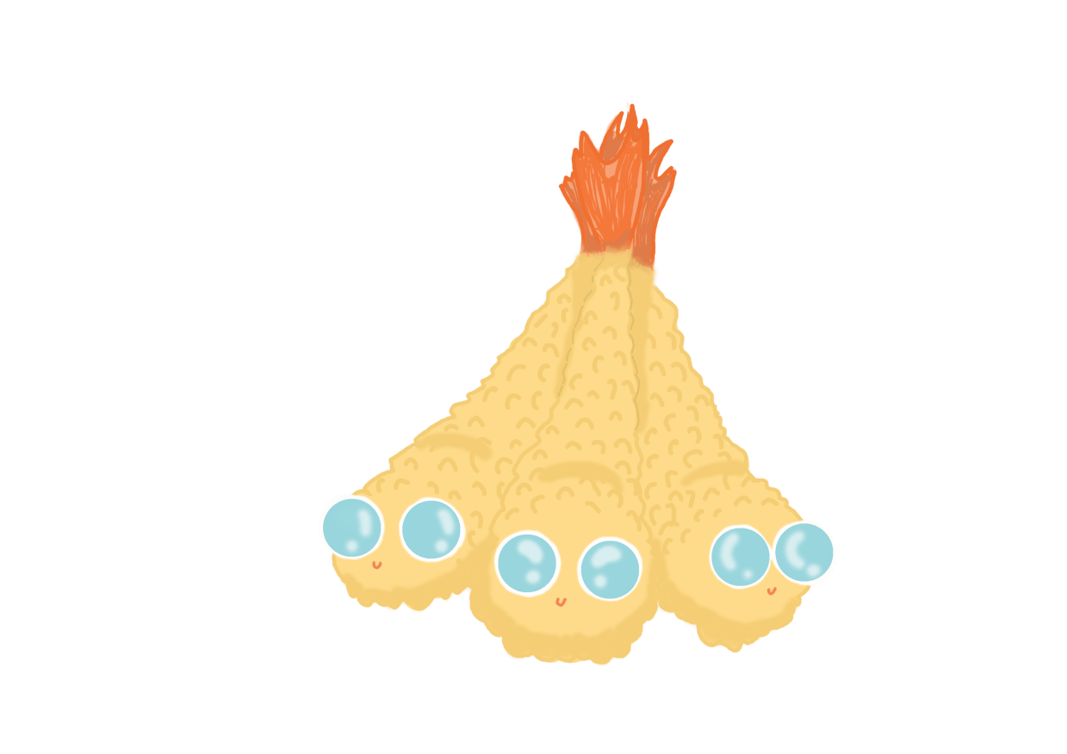
Programming Lessons
Do code in language that at least one other team member is competent in.
Don’t switch game engines midway through development.
Its okay to let designers script elements of your game, your game may even benefit from it.

Slide 9

Management Lessons
Completing a Risk Assesment minimises the chance of the project derailing.
Creating a design document ensures all team members have a complete understanding of the project.
It is important to gain a practical understanding of each members skills.

Slide 10

Questions

